Slide 1
Ideas
27/11/2025

Slide 2
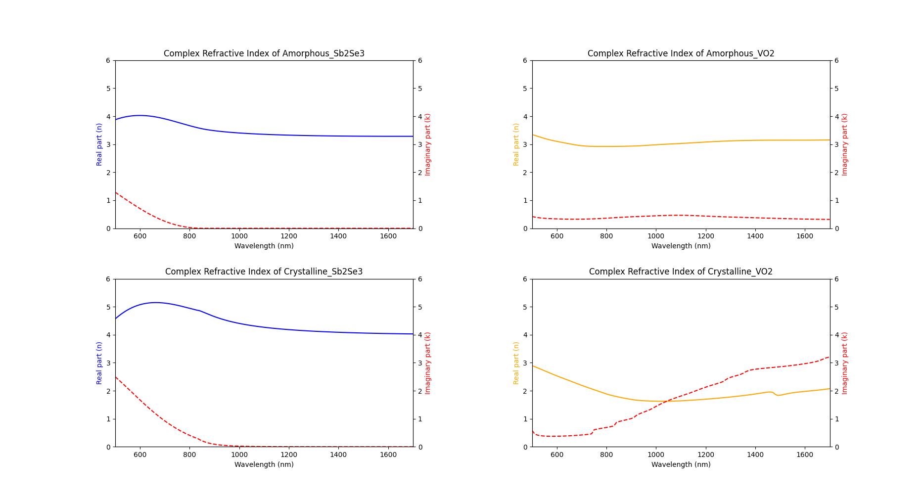
Refractive index @1550nm Sb₂Se₃ vs VO₂
Sb₂Se3 (T_{transition} = 186 °C)
Dataset for A new family of ultra-low loss reversible phase change materials for photonic integrated circuits: Sb2S3 and Sb2Se3
VO₂ (25/100 °C; T_{trans} = 68 °C (volatile))
Thermochromic VO₂-based smart radiator devices with ultralow refractive index cavities for increased performance
Amorphous: 3.2854 + 0.0000j
Crystalline: 4.0499 + 0.0002j
Amorphous: 3.1462 + 0.3388j
Metallic: 1.9277 + 2.9058j

Slide 4
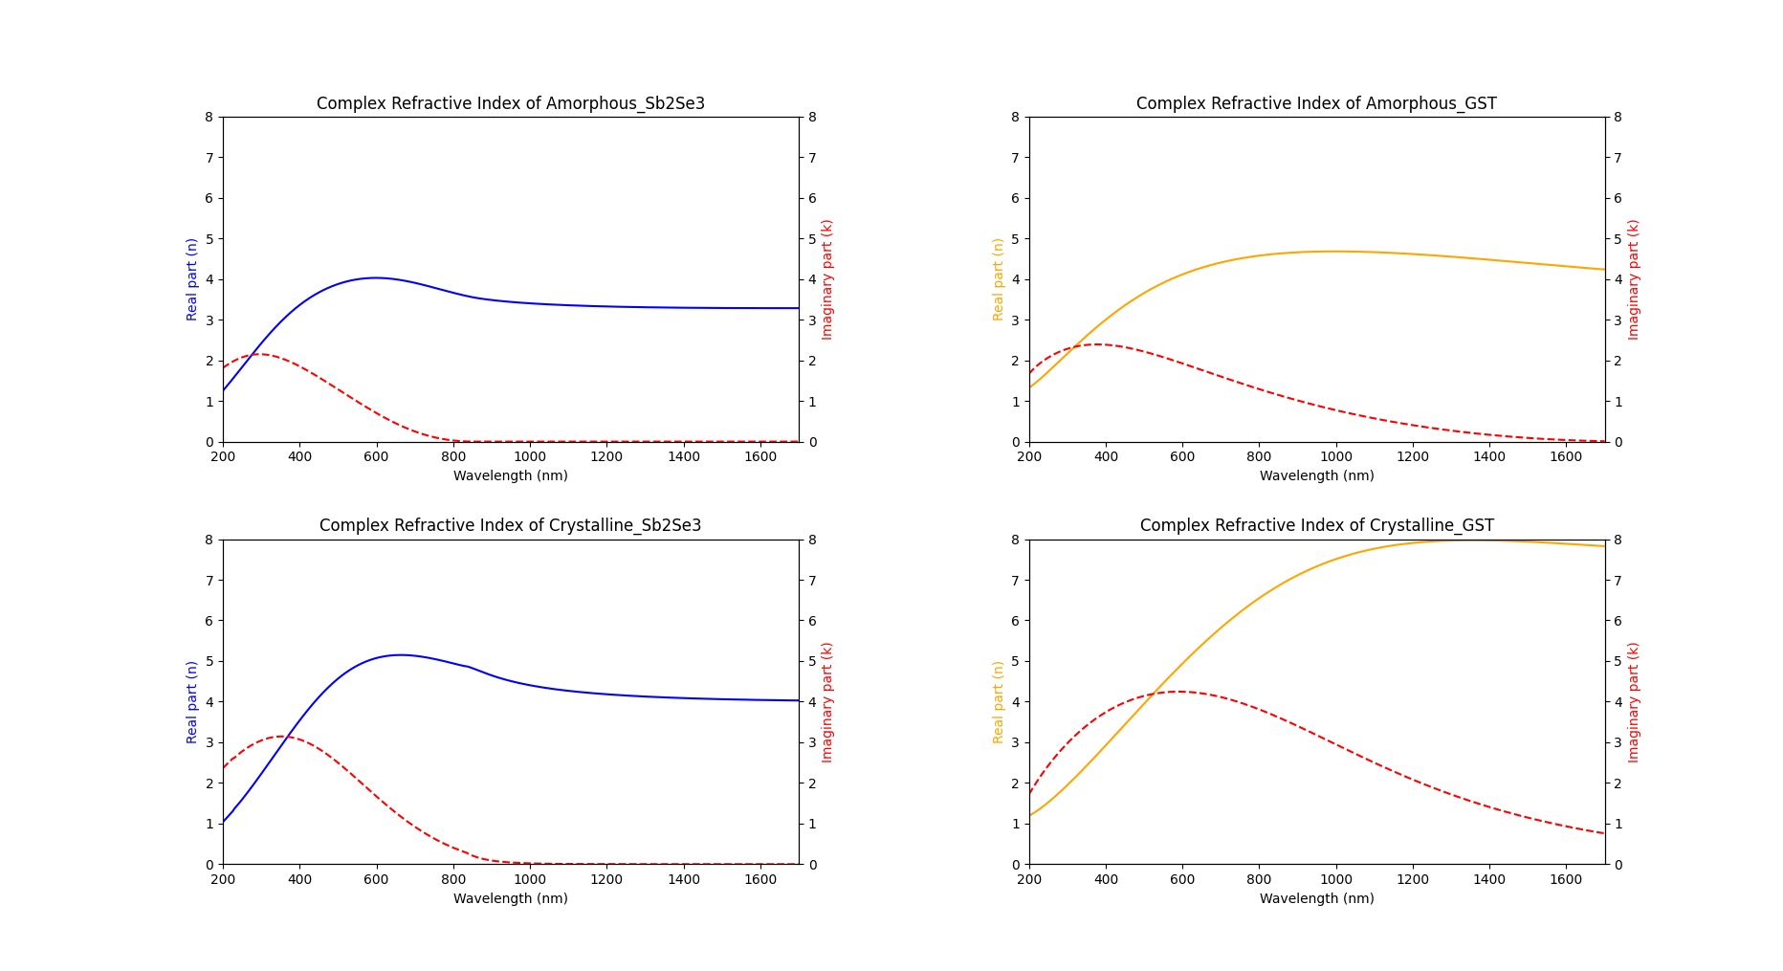
Refractive index @1550nm Sb₂Se₃ vs GST
Sb₂Se3 (T_{transition} = 186 °C)
Dataset for A new family of ultra-low loss reversible phase change materials for photonic integrated circuits: Sb2S3 and Sb2Se3
GST (T_{trans} = 150 °C, T_{amorphization} = 600 °C)
Dataset for A new family of ultra-low loss reversible phase change materials for photonic integrated circuits: Sb2S3 and Sb2Se3
Amorphous: 3.2854 + 0.0000j
Crystalline: 4.0499 + 0.0002j
Amorphous: 4.3534 + 0.0608j
Crystalline : 7.9132 + 1.0331j

Slide 6
Sb2Se3 pros
Low absorption at C-band (no ref need?)
Large Δn b/w phase (ref?)
High switching endurance 10⁷ cycles (Optical switching beyond a million cycles of low-loss phase change material Sb₂Se₃)
Crystalline temperature is relatively low (186 °C) (Optical switching beyond a million cycles…)
In this paper, annealed @200°C for 5 mins.
Will remain stable at telecommunication usage.
Can’t find amorphization temp anywhere.
For comparison, T_{crystallization}: GST =180, Sb₂S₃ =270, GSST = 300+ °C

Slide 7
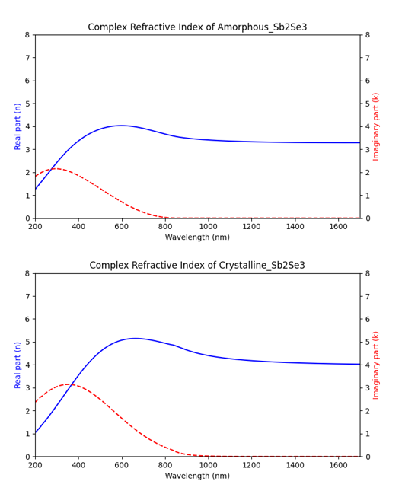
Sb2Se3 as optical limiter
? Might be suitable for usage in short wl, e.g. shorter than 400 nm.
Small absorption coefficient (k) in both phase. @ 1550 nm

Slide 8
Why 532 and 1064 optical limiter?
Standard wl for Nd:YAG (Neodymium-doped yttrium aluminium garnet) laser (2nd harmonic = 532 nm).
Find citation(?)

Slide 9
Refractive index, non-linear effect vs phase transition.
Kerr effect: Intensity dependent
Change due to phase transition: amorphous -> crystalline
“We show that it is possible to shift the transition edge of the filter by several hundred nanometers by utilizing the huge changes in the refractive index of GST. This shift is orders of magnitude larger than that achievable with nonlinear refraction… “ - Broadband Reflective Optical Limiter Using GST Phase Change Material
> Non-linear term should be negligible when compared to index changes due to phase transition.

Slide 10

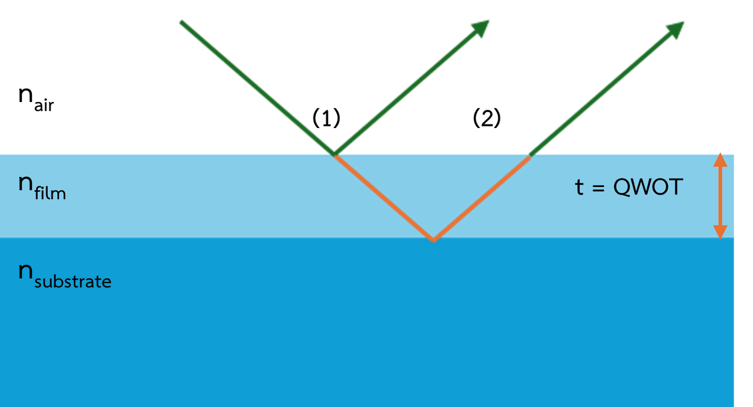

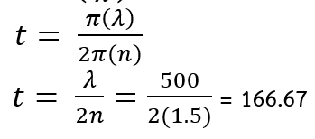
Bachelor’s pptx
2 Theory
Antireflection (AR)
Both device types don’t require Reflection
Increase Transmission and Absorption
(2)
Quarter-Wave Optical Thickness (QWOT)
nA < nF < nS
k=2π/λ
(3.1)
(3.2)
(3.3)
8

Slide 11
Results

Slide 12
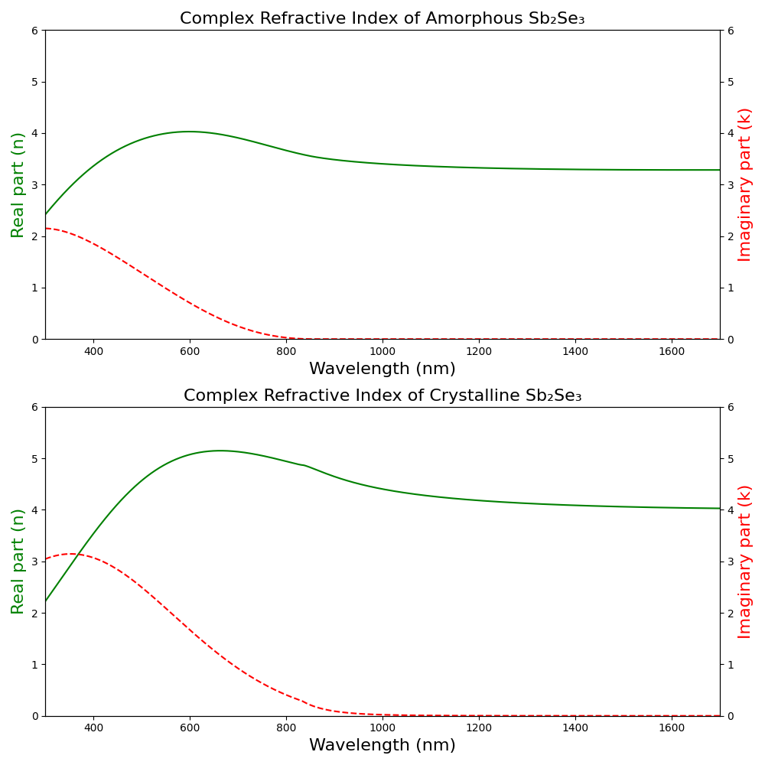
1064 nm Optical limiter
Refractive index of SbSe:
Amo = 3.370 + 0.000000j
Cry = 4.308 + 0.009744j

Slide 13
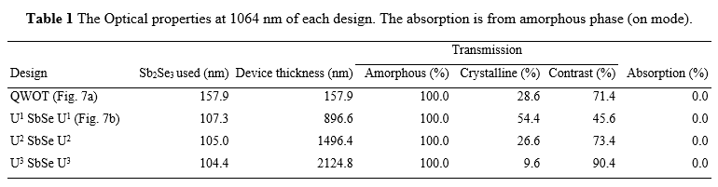
Resonant in amorphous phase

Slide 14
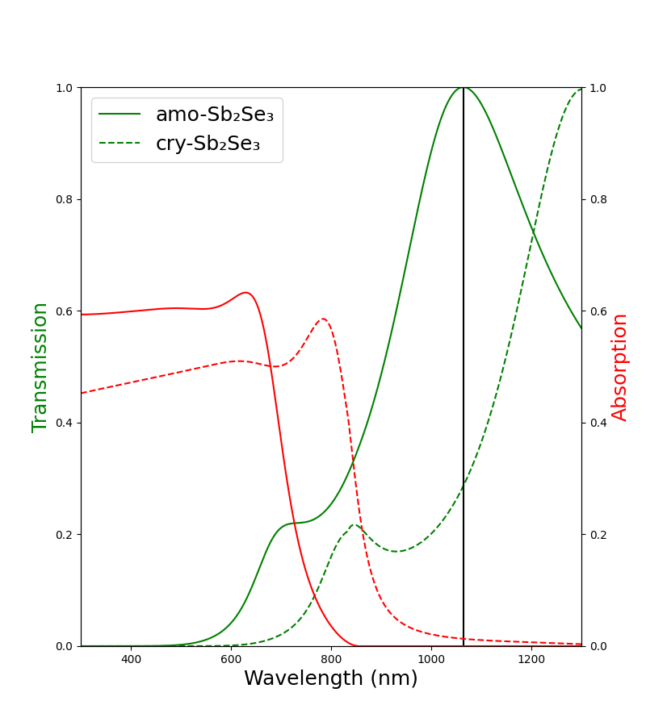
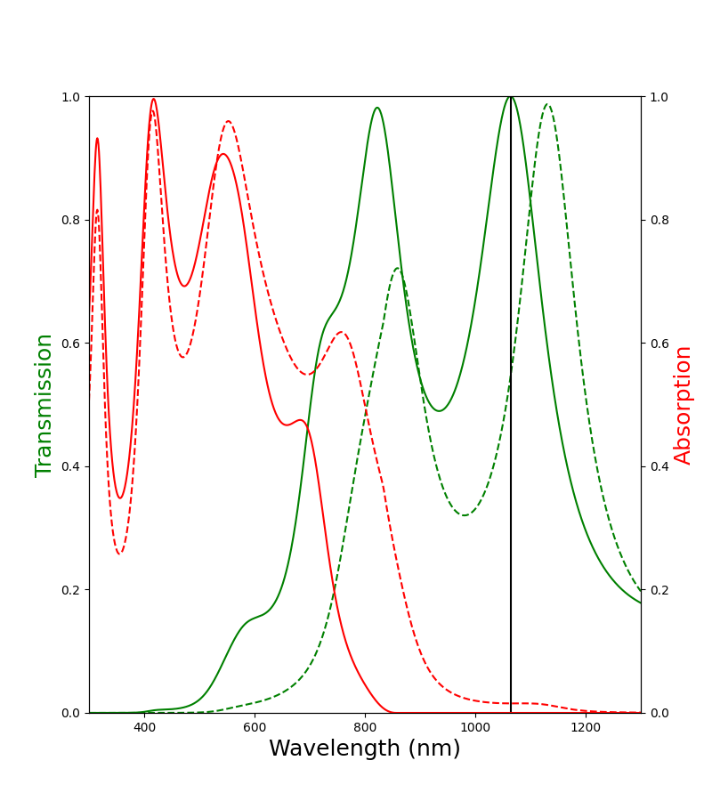
(1)

Slide 15
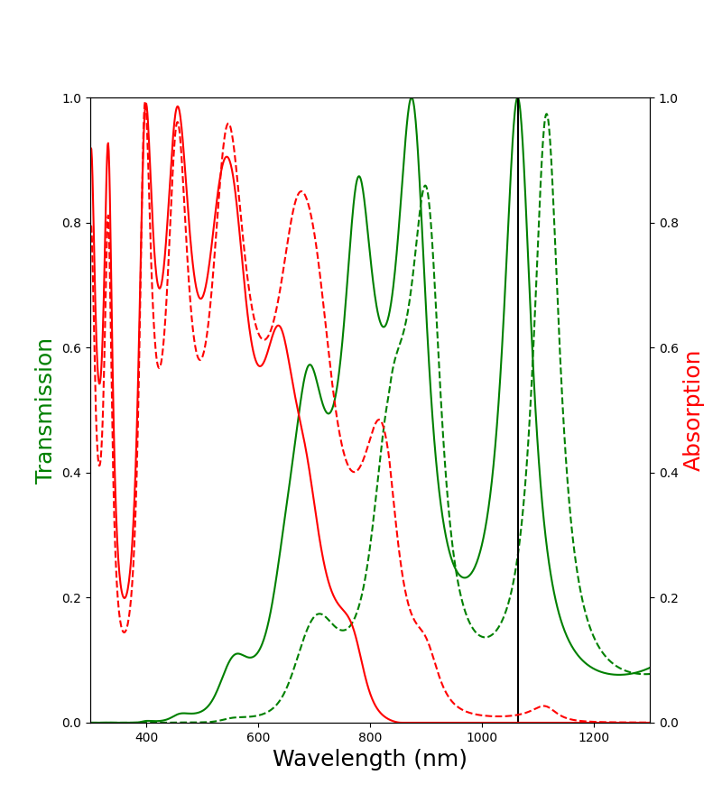
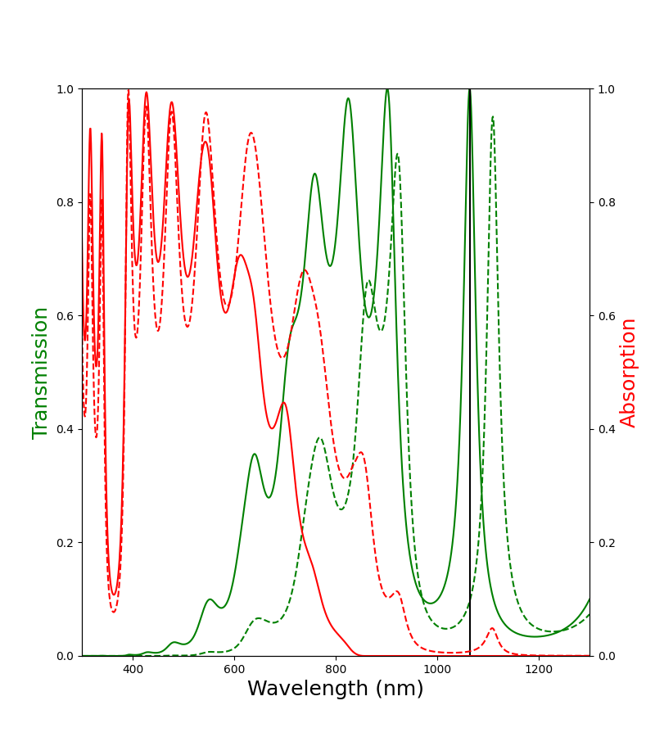
(2)

Slide 16
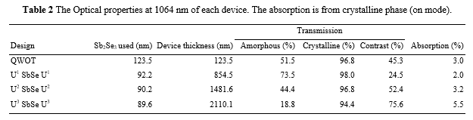
Resonant in crystalline phase

Slide 17
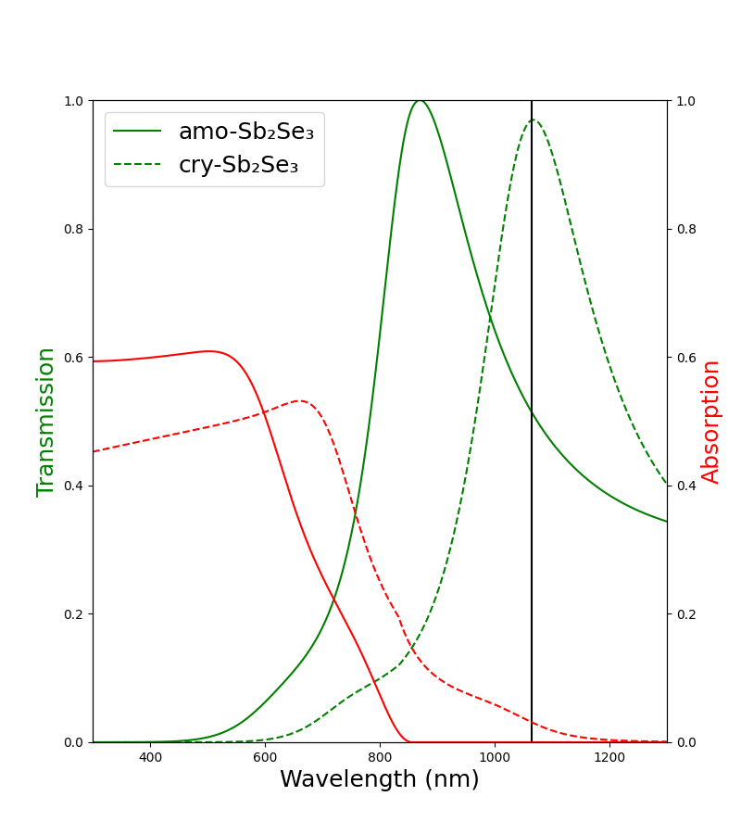
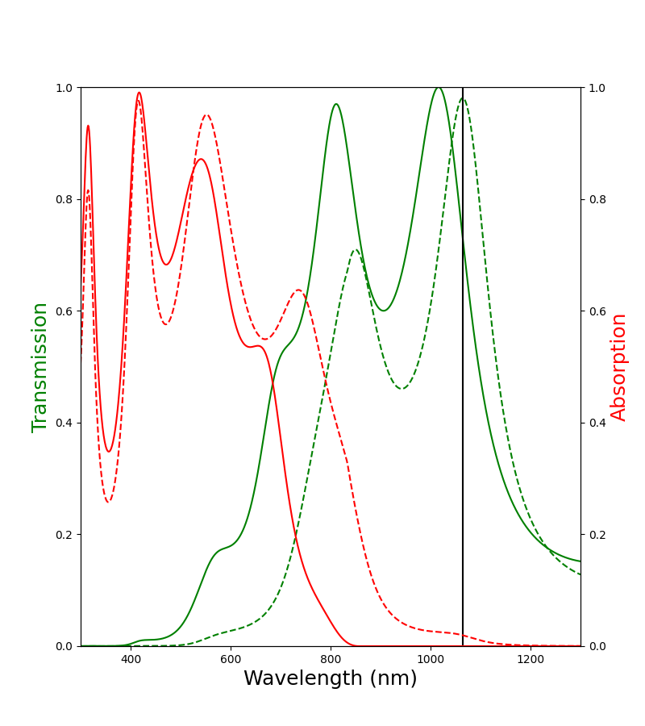
(1)

Slide 18
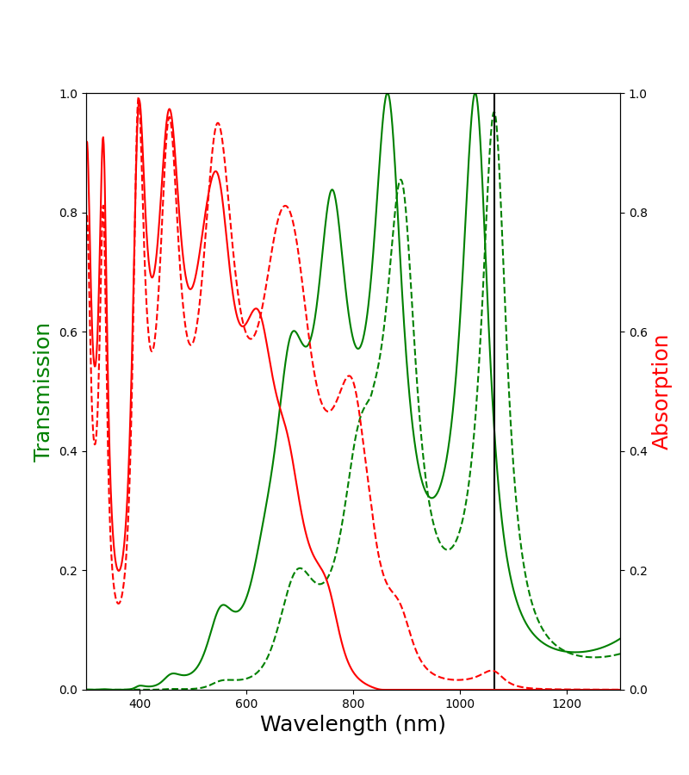
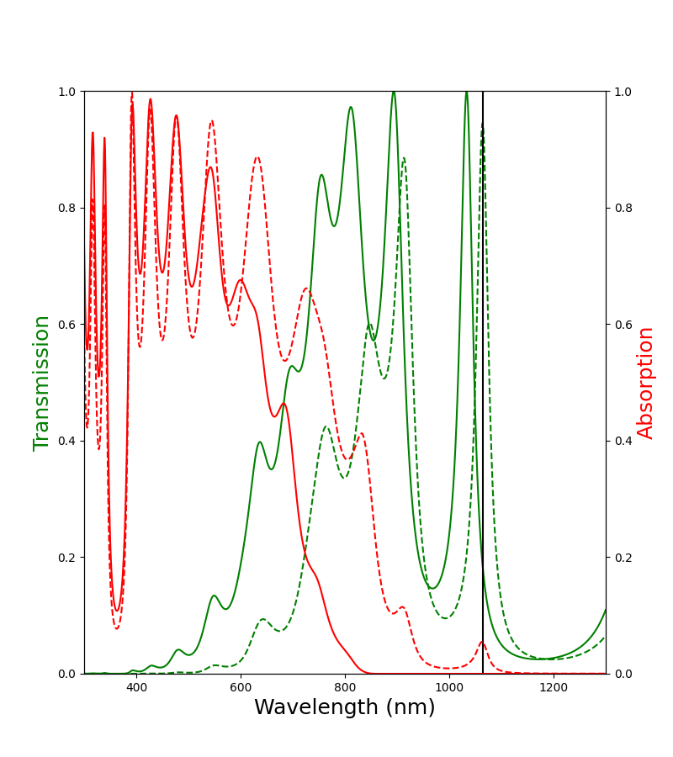
(1)

Slide 19
532 nm Optical limiter
Refractive index of SbSe:
Amo = 3.962 + 1.093042j
Cry = 4.788 + 2.240748j

Slide 20
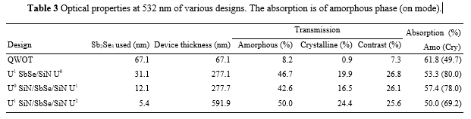
Resonant in crystalline phase

Slide 21
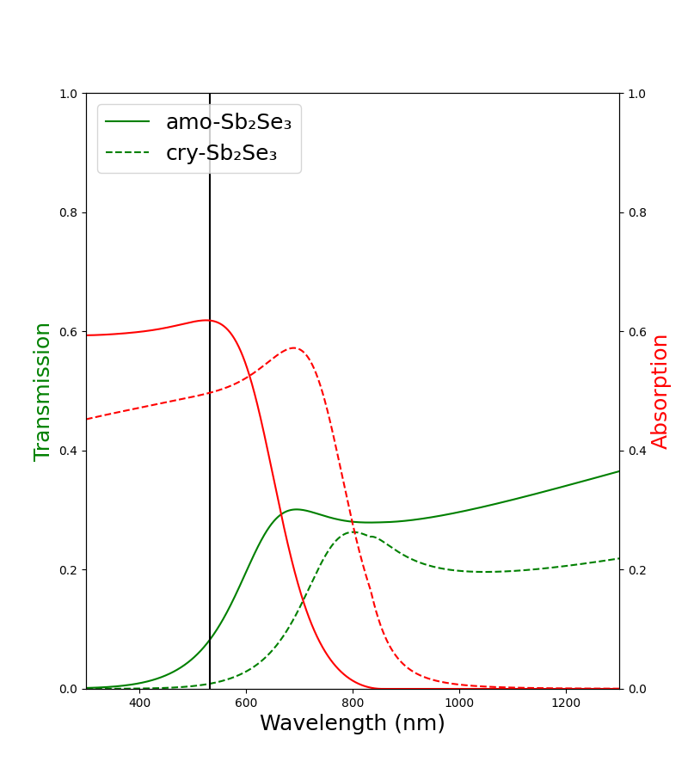
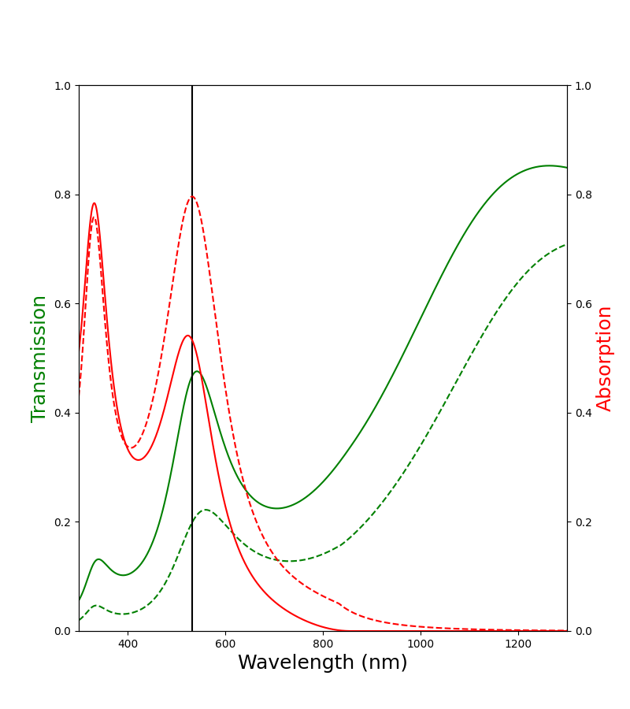
(1)

Slide 22
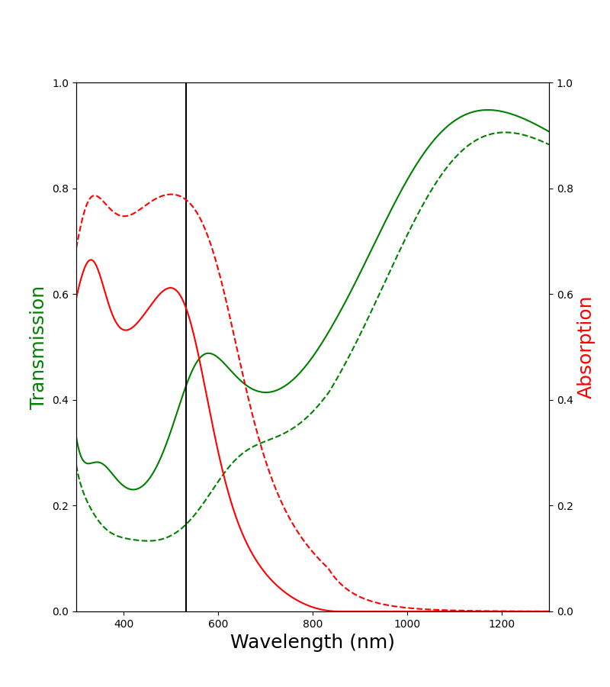
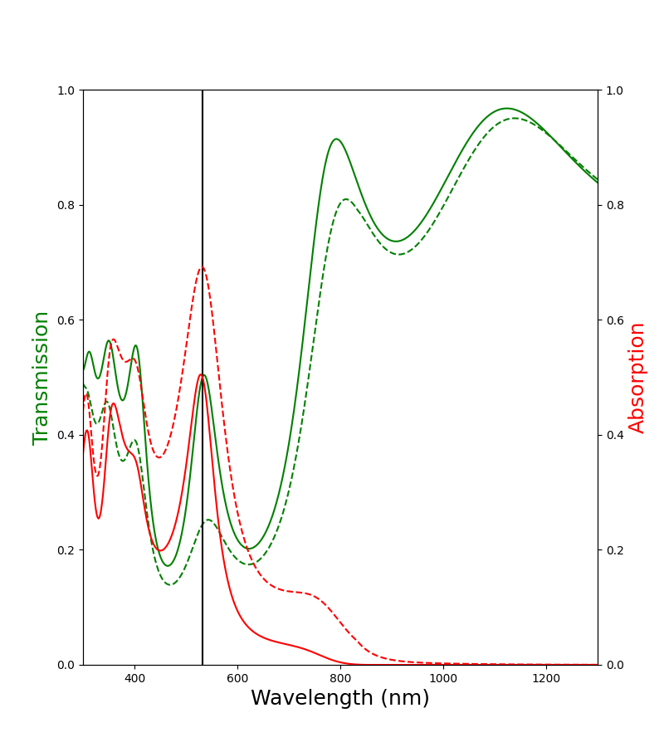
(2)

Slide 23
600 nm Optical limiter
Refractive index of SbSe:
Amo = 3.962 + 1.093042j
Cry = 4.788 + 2.240748j

Slide 24
1064 nm Optical limiter
Reference wavelength = 750 nm
Edge-filter (N=2)
Reference wavelength = 1064 nm
SbSe = QWOT/2 = 24.75 nm
MgF = QWOT = 135.8 nm
Single-layer
Two-layer
Edge-filter (N=1)
TiO2 = QWOT = 115.2 nm
SbSe = QWOT/2 = 24.75 nm
2 unit-cells
SbSe = QWOT/2 = 24.75 nm
SbSe = QWOT/2 = 24.75 nm
SbSe = HWOT = 157.9 nm
MgF2 = QWOT = 135.8 nm
MgF = QWOT = 135.8 nm
1 unit-cell
SbSe = QWOT = 78.9 nm
SbSe = QWOT/2 = 24.75 nm
SbSe = QWOT/2 = 24.75 nm
SiO2 = 3 mm
SiO2 = 3 mm
SiO2 = 3 mm
SiO2 = 3 mm

Slide 25
532 nm Optical limiter
Reference wavelength = 532 nm
Single-layer
Single-layer
(non QWOT)
Fabry-Perot
N=1(MgF/SbSe) M=0
H = TiO2, L = MgF2
Fabry-Perot
N=1(SbSe/TiO/SbSe) M=0
H = TiO2, L = MgF2
TiO2 = QWOT/2 = 27.14 nm
TiO2 = QWOT/2 = 27.14 nm
SbSe = 6.6 nm
SbSe = 7.1 nm
MgF = 51.4 nm
TiO2 = 34.6 nm
SbSe = 7.1 nm
TiO2 = QWOT/2 = 27.14 nm
TiO2 = QWOT/2 = 27.14 nm
MgF = QWOT = 96.08 nm
MgF = QWOT = 96.08 nm
1 unit-cells
1 unit-cell
SbSe = HWOT = 67.2 nm
TiO2 = 56.6 nm
TiO2 = QWOT/2 = 27.14 nm
TiO2 = QWOT/2 = 27.14 nm
SbSe = 22.6 nm
TiO2 = QWOT/2 = 27.14 nm
TiO2 = QWOT/2 = 27.14 nm
SiO2 = 3 mm
SiO2 = 3 mm
SiO2 = 3 mm
SiO2 = 3 mm

Slide 26
1064 nm Optical limiter
532 nm Optical limiter
Endurance simulation
Single-layer design (HWOT)
Two-layer design (QWOT)
Edge-filter design (N=3)
*ถ้ามีเวลา Edge-filter design (N=1, 5, 8)
Endurance simulation
Single-layer
Two-layer (non QWOT)
Fabry-Perot: N1 (MgF/SbSe) M0

Slide 27
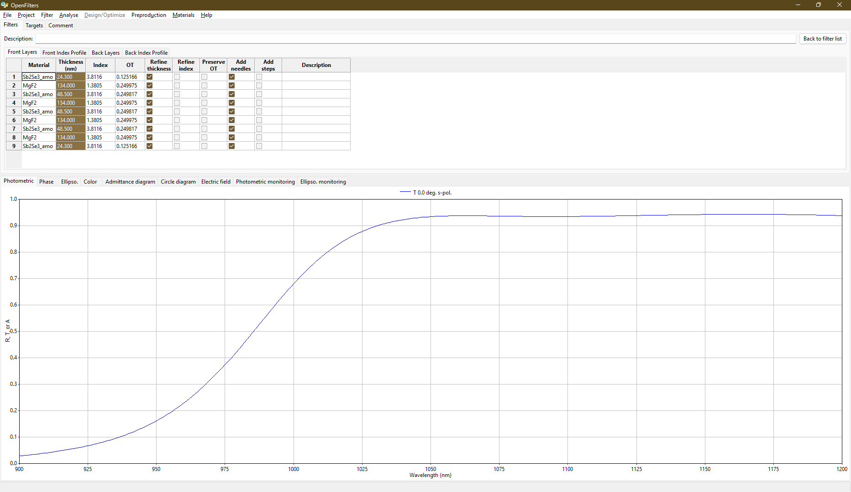
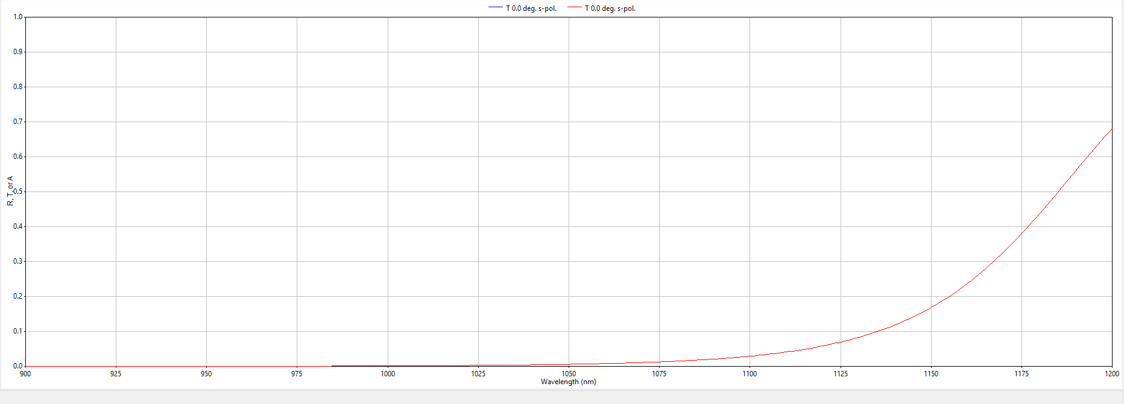
9-layer edge filter
T(amo) = 93.8%
T(cry) = 0.9%

Slide 28
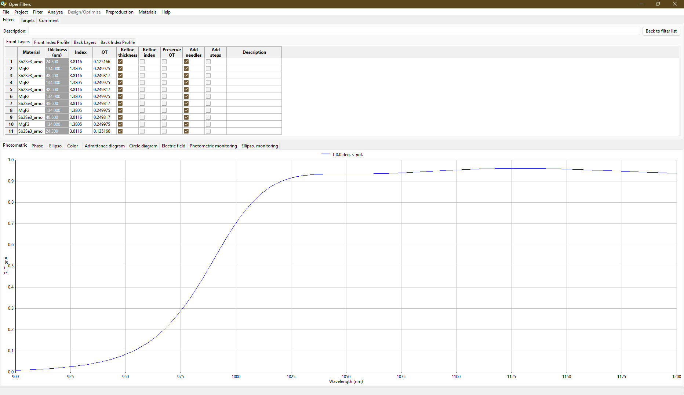
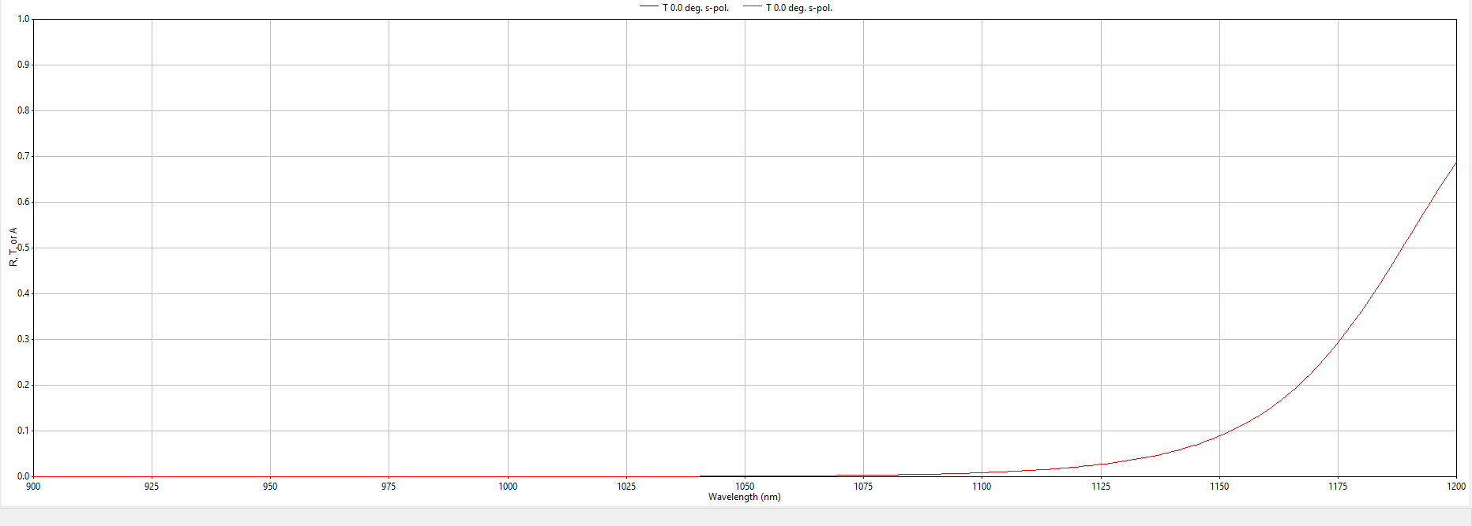
11-layer edge filter
T(amo) = 93.6%
T(cry) = 0.21%

